Slide 1
GAME AUTOMATION USING OPENCV
-by
Devansh Kashyap (1706036)
Himanshu (1706040)
Harsh Singh (1706038)

Slide 2
Introduction
Our main aim is to make a automation code with the help of Open CV and Pyautogui which can detect hand gestures through web cam and respond according to it with correct key press

Slide 3
LIBRARIES USED
01
02
Numpy
OpenCV
03
Math
To store large multidirectional array
To access the webcan and capure frames
04
PyAutoGUI
For mathmatical calculations
To control the keyboard

Slide 4
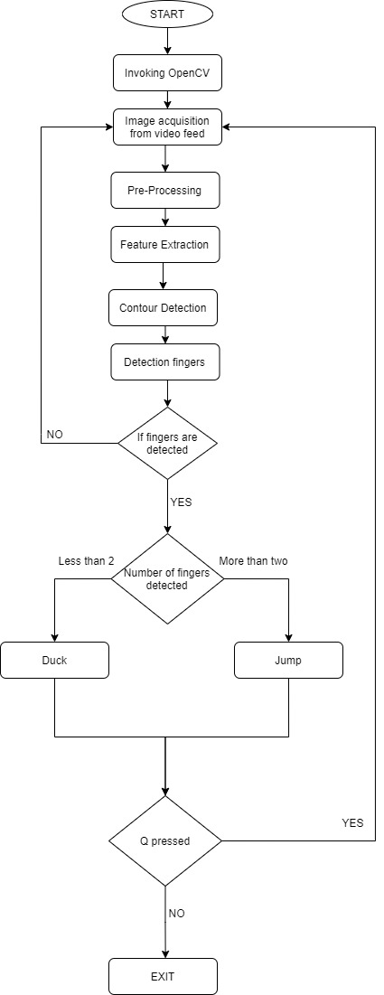
UML DIAGRAM

Slide 5
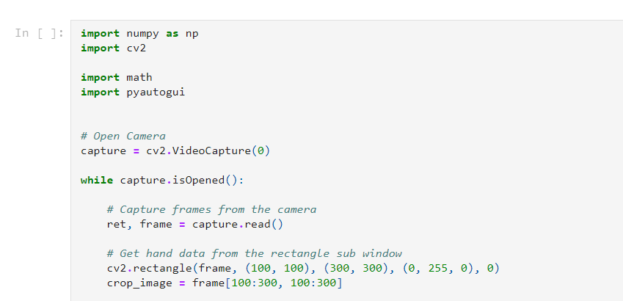

Slide 6
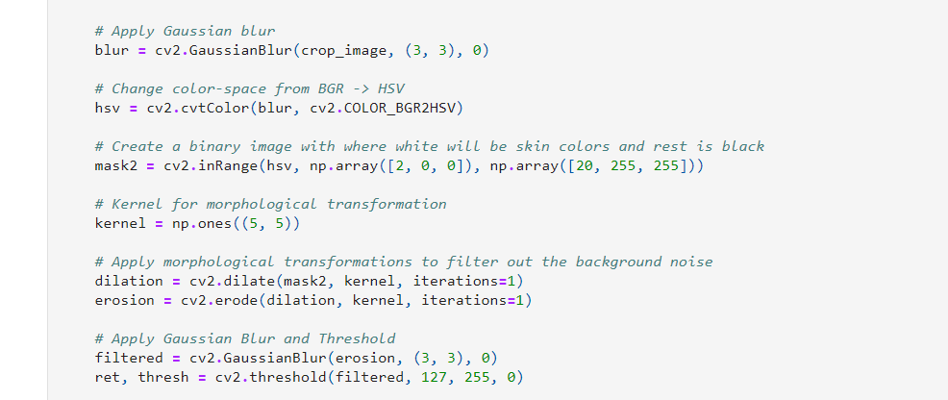

Slide 7
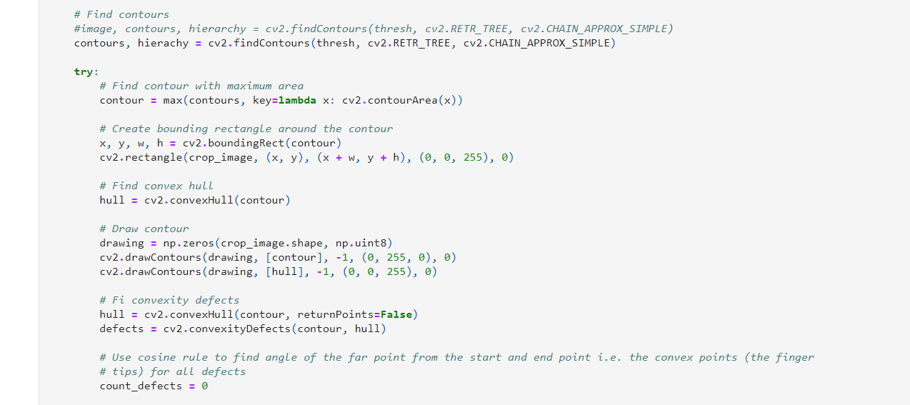

Slide 8
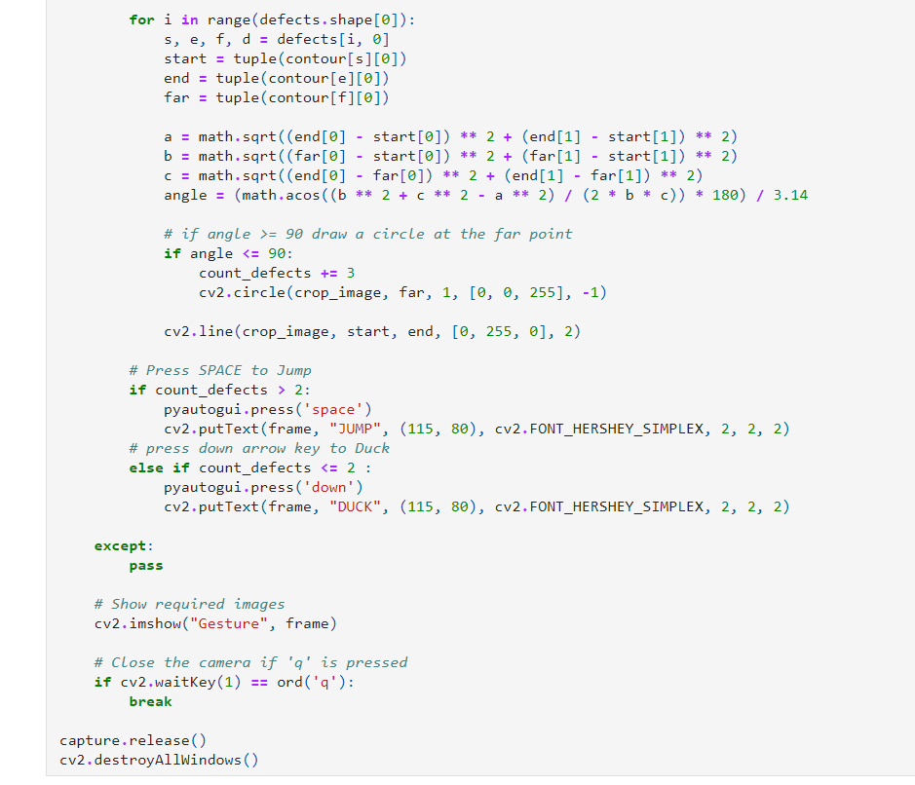

Slide 9
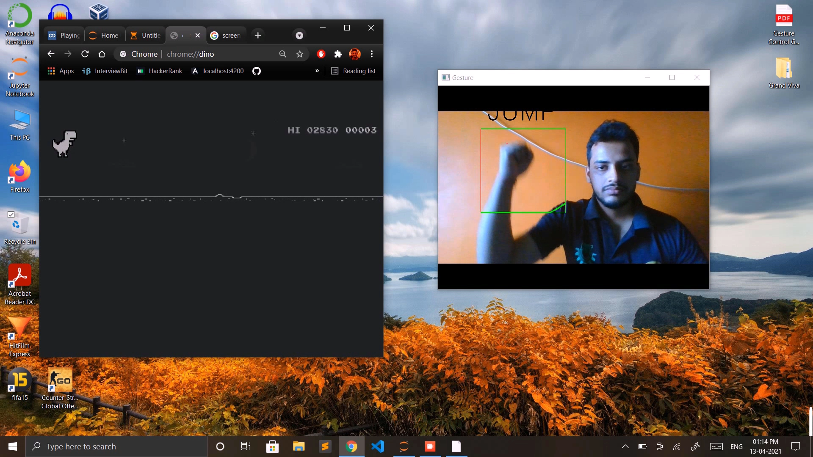
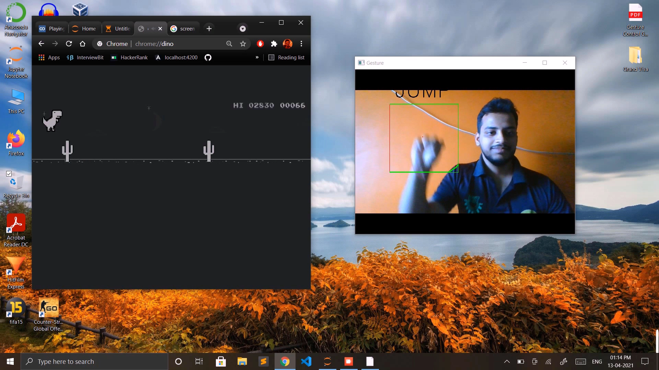

Slide 10
Video Link
http://tiny.cc/gjfwtz

Slide 11
THANK YOU!

